Slide 1
Shark Attacks Database
-Shark explorers business case-
Alicia Caminero | Daniela García
Celia Manzano | Ema Rosas

Slide 2
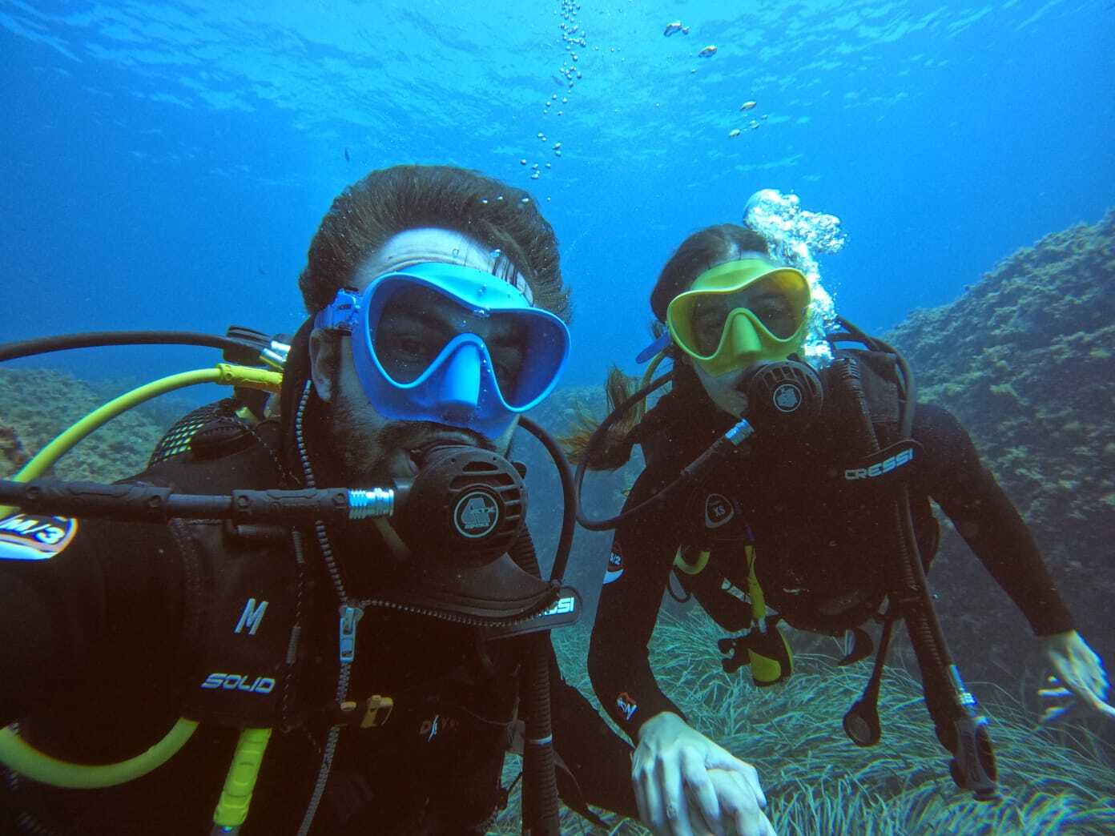
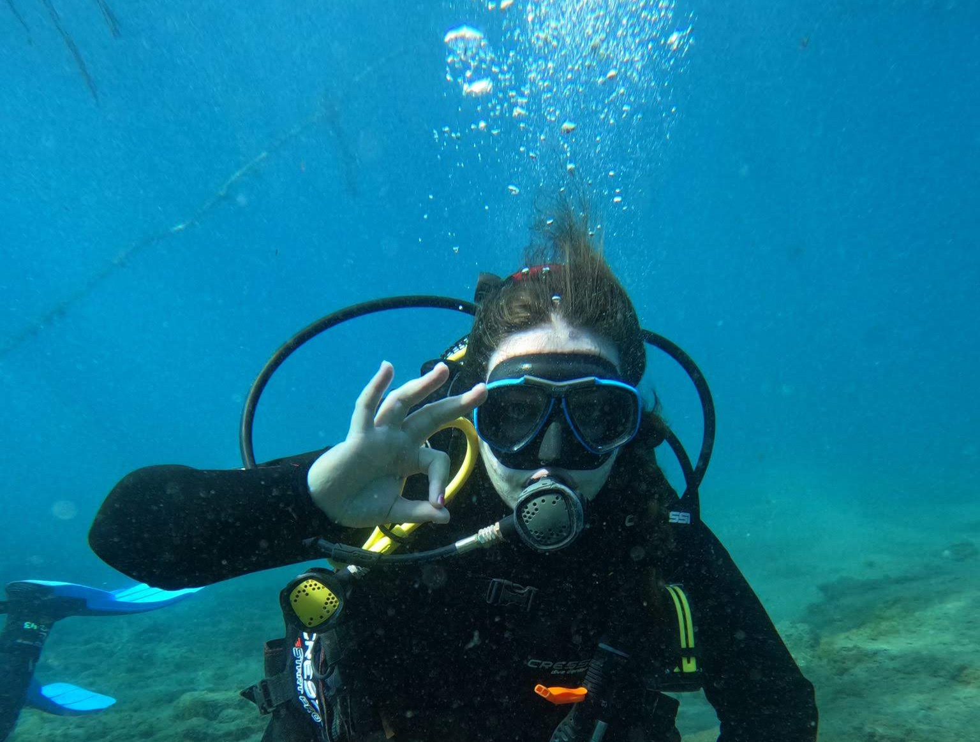
Bussiness Case
· We are 4 young entrepreneurs willing to create a business from our passion: aquatics sports
·The idea is clear: offering experiences, primarily focusing on encounters with marine wildlife, especially sharks.
·Our services will include: international diving expeditions and raising awareness about the importance of preserving ocean habitats
·We are willing to create safe interactions for all: animals and people

Slide 3
Project Overview
To address the challenge of safe shark interactions, we discovered the Shark Attacks database online. We intend to utilize this resource to:
Refine our destination choices
Improve safety when engaging with various shark species
Ensure informed decision-making while prioritizing conservation efforts, recognizing that areas with higher attack rates are also critical habitats for sharks.
This approach will help us promote both safety and environmental stewardship in our activities.

Slide 4
Analysis Methodology
Data Cleaning
Removing unnecessary columns and duplicates while standardizing relevant columns for consistency. Missing data is addressed by assigning the category "Unknown" to indicate unavailable information.
Conclusion & Action Plan
Now that we have key insights answering our questions, we can begin our adventure. Destinations and exploration trips have been decided, ensuring informed actions moving forward.
Second step
First Step
Third Step
Key Questions
Structuring the data using exploratory data analysis (EDA) techniques to uncover key insights and trends. Visualizations are created to effectively communicate these findings

Slide 5
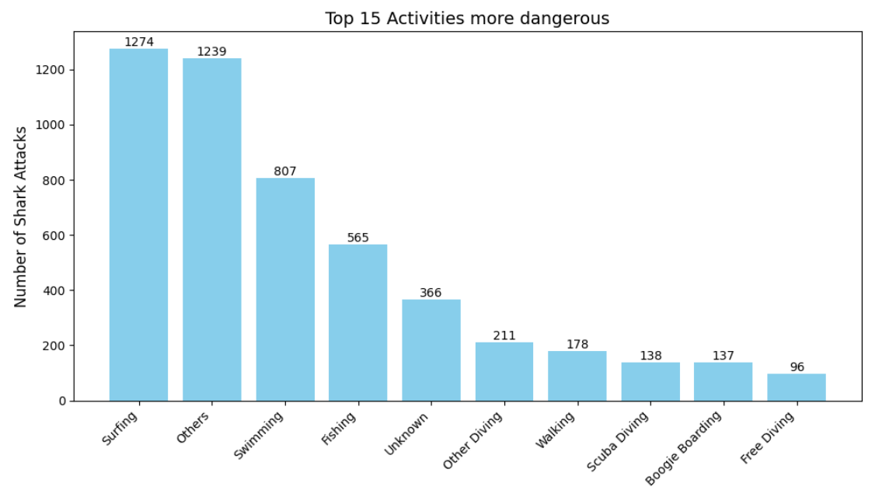
Key questions
What activity is most dangerous?

Slide 6
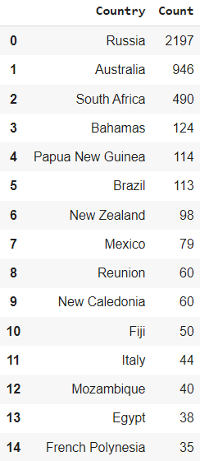
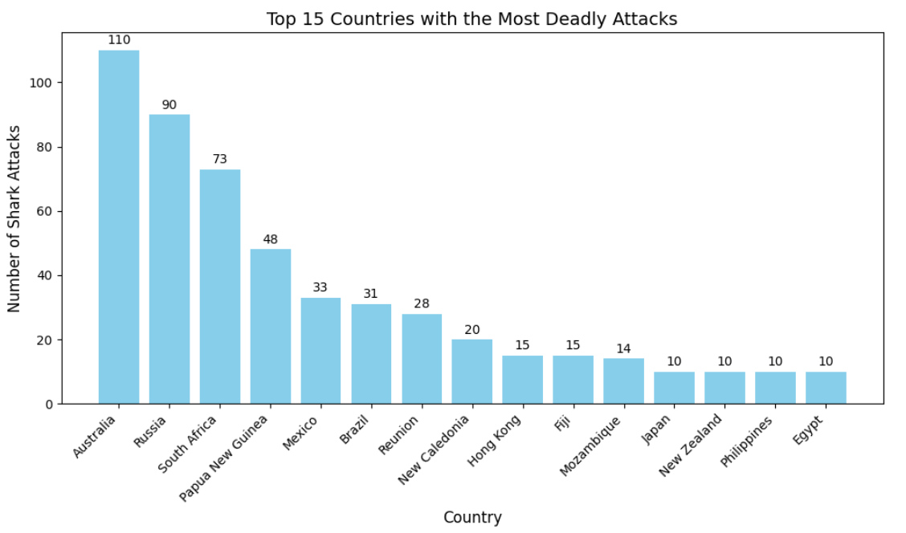
Key questions
Where do most attacks occur? And where are they fatal?

Slide 7
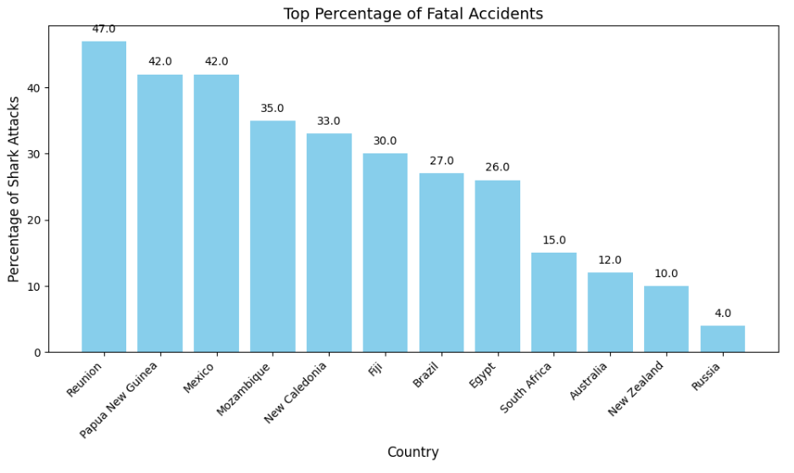
Key questions
Which are the countries with higher rate of fatal accidents?

Slide 8
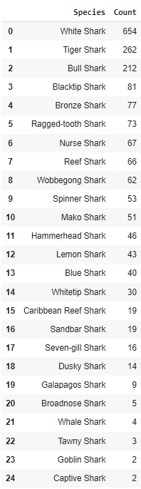
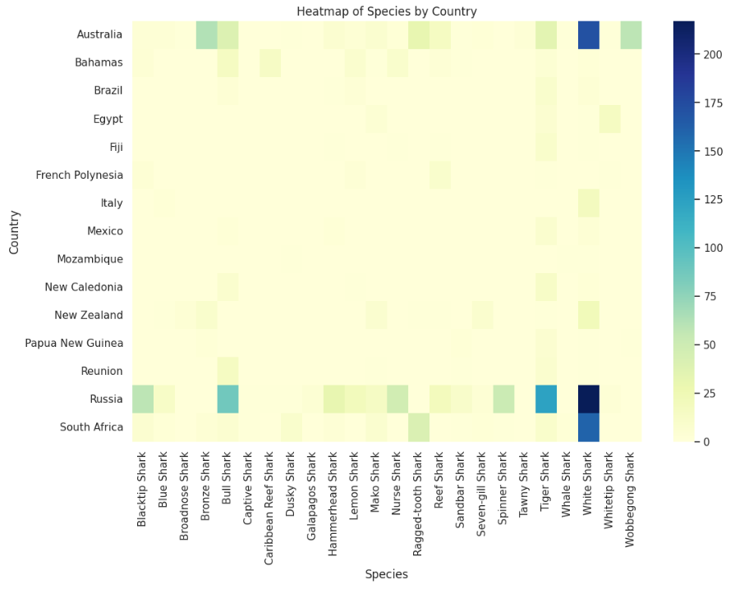
Key questions
Do these shark attacks in the top 15 countries with most attacks relate
to any specific species?

Slide 9
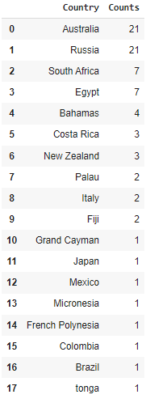
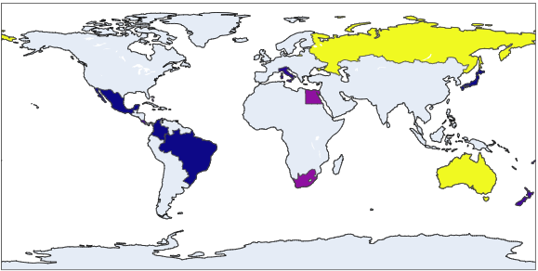
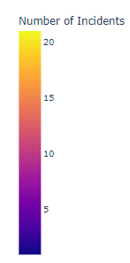
Key questions
When it comes to scuba diving, where do shark attacks most commonly occur?

Slide 10
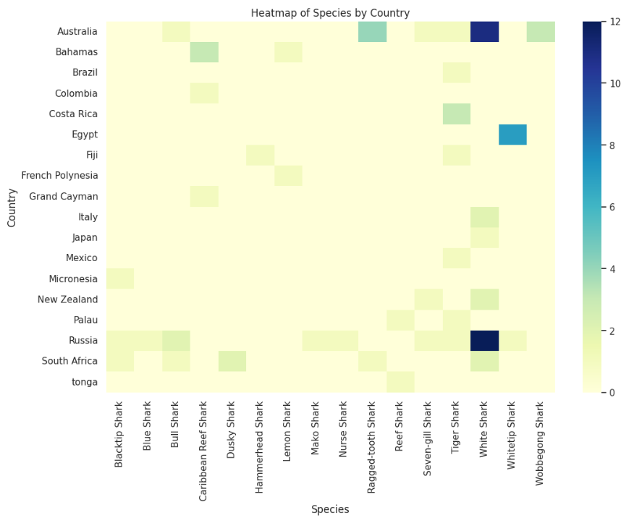
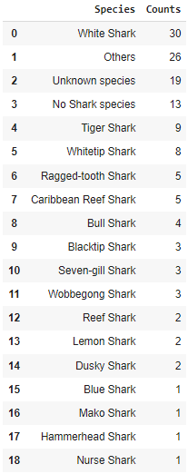
Key questions
How do countries relate to different shark species in the context of scuba diving?

Slide 11
Conclusions
White shark are the most dangerous, due to be apex predators
Top three countries with higher attacks number: Russia, Australia and South Africa , but not the deadliest
Swimming, surfing and fishing are the most dangerous activities
Some species like: hammerhead, tiger or nurse sharks are usually an attraction to expertise divers and should not represent any danger
Avoid bad practises like feeding them or interfering their natural habitat

Slide 12
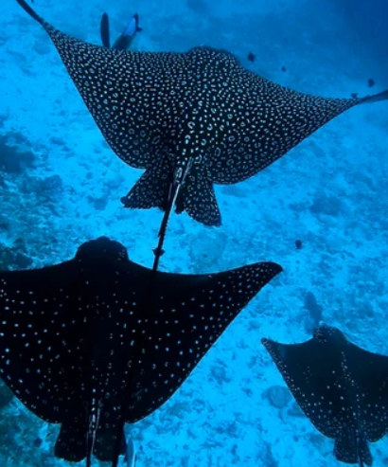
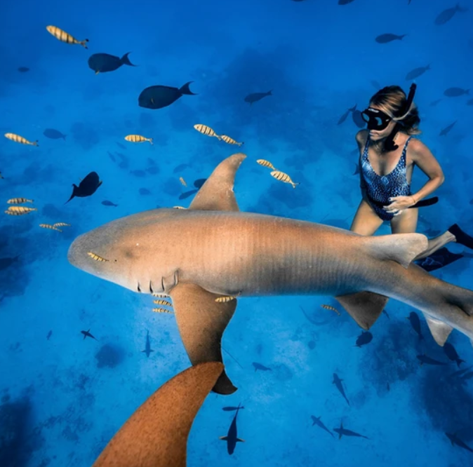
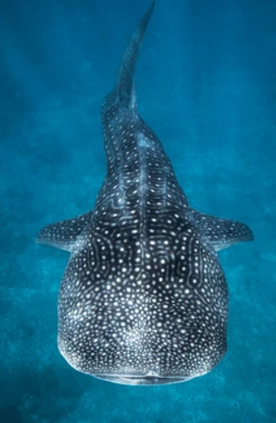
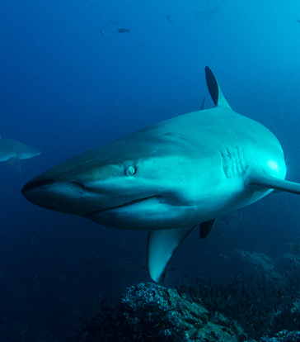
Posible destinations & observations
Other wildlife observations
Nurse Shark
MALDIVAS
MAURICIO
GALÁPAGOS
Whale Shark
Galapagos Shark

